Slide 1



Calculating the Zeeman effect beyond first order in ³He⁺
An Investigation of The Higher Order Zeeman Effect
Evan M.R. Petrimoulx, A.T. Bondy, G.W.F. Drake
University of Windsor
University of Windsor Physics with Thesis Defence

Slide 2
Table of Contents
Motivation and Significance
The Ordinary Zeeman Effect
The Quadratic Zeeman Effect
Perturbation Theory
Recursion Relations 1/r
Recursion Relations r²
Dalgarno Interchange Theorem
Relativistic Corrections
Double Perturbation Theory
Results
Future Work
U. Windsor Undergraduate Seminar
Calculating the Zeeman effect beyond first order in ³He | Evan M.R. Petrimoulx, University of Windsor

Slide 3
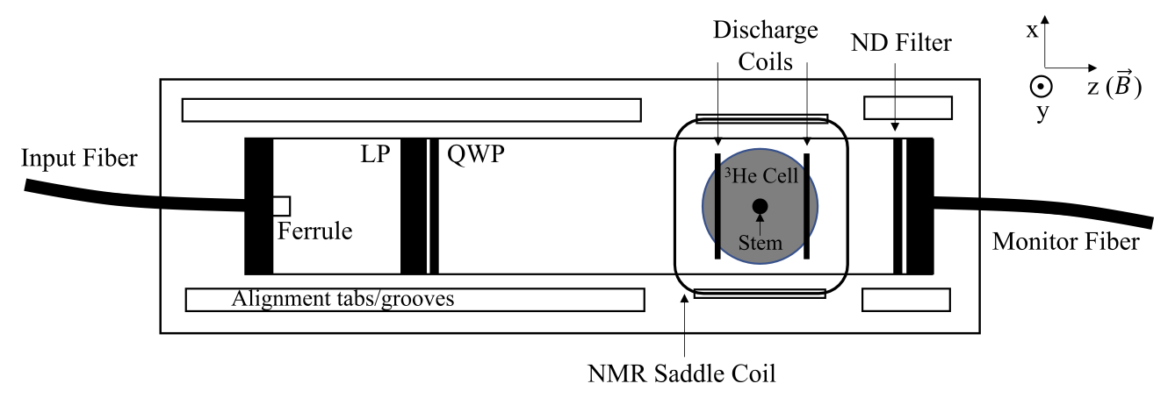
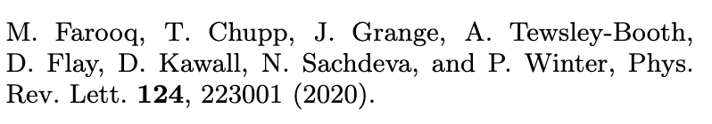
Motivation for the project
Magnetometer at Ann Arbor
- Max Planck Heidelberg group
- Researchers in Ann Arbor, Michigan have constructed a magnetometer with ³He and used it for absolute calibration comparisons to two water-NMR magnetometers at 1.45 T.
Are any corrections to the linearity of the two-state splitting due to some kind of mixing of higher order terms in the Zeeman effect? My work will provide insight on these effects and allow for further development of more precise measuring equipment.
The effect is electronic, not nuclear. The nuclear effect is suppressed by a factor of
- Klaus Blaum's Max Planck Heidelberg group is conducting an experiment on a self-calibrated measurement of the helion magnetic moment. They are using a ³He⁺ magnetometer to make their measurements. Our work along with the work at Ann Arbor, Michigan will help them tune their equipment and aid in the search of new physics!
Calculating the Zeeman effect beyond first order in ³He | Evan M.R. Petrimoulx, University of Windsor

Slide 4
What is the Zeeman effect?
When an atom is placed into an external magnetic field, its energy levels are shifted. The shifting of these Energy levels in known as the Zeeman effect and is dictated by the magnetic quantum number.
The effect can be derived using the canonical momentum
Where is the new term that accounts for the momentum from an external magnetic field.
The canonical momentum can be translated into its quantum mechanical operator analogue and used in the Hamiltonian to show the energy splitting from the Zeeman effect.
Calculating the Zeeman effect beyond first order in ³He | Evan M.R. Petrimoulx, University of Windsor
Notes:
HYLLERAAS IS ONLY FOR 2-3 BODY PROBLEMS

Slide 5
What is the Zeeman effect?
Expanding the expression leads to a 3 term Hamiltonian
The quadratic Zeeman effect
Part of the linear Zeeman effect
Calculating the Zeeman effect beyond first order in ³He | Evan M.R. Petrimoulx, University of Windsor
Notes:
HYLLERAAS IS ONLY FOR 2-3 BODY PROBLEMS

Slide 6
Not the whole story:
There is one more effect which scales proportional to the magnetic field strength that contributes to the overall linear Zeeman effect. The Spin interaction
Combining this with the previously derived Hamiltonian and using , the linear Zeeman effect is
Which has solutions dependent on the magnetic quantum number
Calculating the Zeeman effect beyond first order in ³He | Evan M.R. Petrimoulx, University of Windsor
Notes:
HYLLERAAS IS ONLY FOR 2-3 BODY PROBLEMS

Slide 7
Applications to Magnetometry
Magnetometry deals with the measurement of magnetic fields. It has applications in
Archaeology
Geophysics
Medical Imaging (MRI)
Magnetometers assume a linear relationship between the magnetic field strength and frequency difference between split spectral lines.
The linear relationship is used in practice for important equations such as the Larmor equation, which is especially important in MRI.
Many high-precision magnetometers assume a linear relationship between frequency and magnetic field, which means that all corrections discussed in this work serve as methods of eliminating sources of uncertainty from high-precision measurements!
Calculating the Zeeman effect beyond first order in ³He | Evan M.R. Petrimoulx, University of Windsor
Notes:
HYLLERAAS IS ONLY FOR 2-3 BODY PROBLEMS

Slide 8
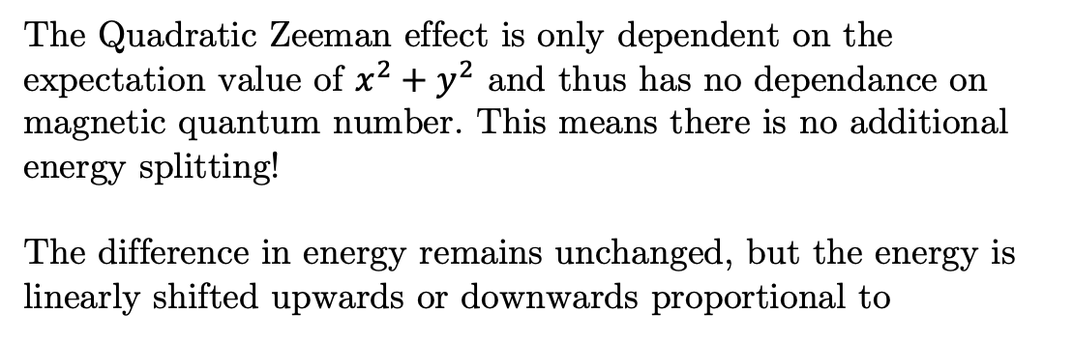
What about the quadratic Zeeman effect?
The Quadratic Zeeman effect is only dependent on the expectation value of $x^{2}+y^{2}$ and thus has no dependance on magnetic quantum number. This means there is no additional energy splitting!
The difference in energy remains unchanged, but the energy is linearly shifted upwards or downwards proportional to
The effect is still significant and plays a role in the higher order effects discussed later.
Calculating the Zeeman effect beyond first order in ³He | Evan M.R. Petrimoulx, University of Windsor
Notes:
HYLLERAAS IS ONLY FOR 2-3 BODY PROBLEMS

Slide 9
The magnetic dipole moment operator
The magnetic dipole moment operator represents the interaction of a magnetic dipole moment with an external magnetic field. It is described via the following equation:
Where the second term in the brackets accounts for the relativistic correction to the kinetic energy of the electron, and the third term is the potential energy due to the Coulomb interaction between the electron and the nucleus. The first term corresponds to the ordinary Zeeman Effect.
The Bohr magneton
The ordinary Zeeman effect contributes for ³He⁺ because of spin, but not for ³He because it has zero spin.
Relation to magnetic quantum number
Calculating the Zeeman effect beyond first order in ³He | Evan M.R. Petrimoulx, University of Windsor
Notes:
HYLLERAAS IS ONLY FOR 2-3 BODY PROBLEMS

Slide 10
Including the nuclear Zeeman effect:
Calculating the Zeeman effect beyond first order in ³He | Evan M.R. Petrimoulx, University of Windsor
Notes:
HYLLERAAS IS ONLY FOR 2-3 BODY PROBLEMS

Slide 11
Perturbation Theory
Starting with the Basic Hamiltonian Equation:
We can expand the wavefunction and its energies as a power series in λ:
And write our total Hamiltonian as the sum of the unperturbed Hamiltonian added with the perturbed term
Combining all 4 equations together we produce the following result:
Calculating the Zeeman effect beyond first order in ³He | Evan M.R. Petrimoulx, University of Windsor
Notes:
HYLLERAAS IS ONLY FOR 2-3 BODY PROBLEMS

Slide 12
Perturbation Theory cont’d
We can rearrange the equation by collecting powers of λ:
Where each power of λ corresponds to a higher order correction. We can then write an equation for each power of λ:
Calculating the Zeeman effect beyond first order in ³He | Evan M.R. Petrimoulx, University of Windsor
Notes:
HYLLERAAS IS ONLY FOR 2-3 BODY PROBLEMS

Slide 13
First-order perturbation theory:
The “First Order” of business is to find . We can do this by multiplying through by
We now have a second order inhomogeneous differential equation to solve to find , and we can use the method
of Frobenius to solve it.
Calculating the Zeeman effect beyond first order in ³He | Evan M.R. Petrimoulx, University of Windsor
Notes:
HYLLERAAS IS ONLY FOR 2-3 BODY PROBLEMS

Slide 14
Recursion Relations:
To solve our perturbation equation where we start with:
Which once we differentiate and perform a shift of index for the summations we get:
To solve the equation, we then must solve the recursion relation for a_{j}
The rest of the terms in the series are all equal to zero, since there are no more higher powers of r on the RHS to match the groupings on the LHS.
Calculating the Zeeman effect beyond first order in ³He | Evan M.R. Petrimoulx, University of Windsor
Notes:
HYLLERAAS IS ONLY FOR 2-3 BODY PROBLEMS

Slide 15
Recursion Relations cont’d:
Because of this, there are two possible solutions. One where the series diverges to infinity, and there are no direct recursive solutions, and one where the series does terminate. The terminating case happens when we set the repeating terms (at j=2 and j=3) to zero.
Now we can write the full series expansion:
And can be determined using the orthogonality relation:
Calculating the Zeeman effect beyond first order in ³He | Evan M.R. Petrimoulx, University of Windsor
Notes:
HYLLERAAS IS ONLY FOR 2-3 BODY PROBLEMS

Slide 16
Recursion Relations cont’d:
So, then we finally have an (unnormalized) result for the first order correction to the wave function for a 1/r perturbation:
Calculating the Zeeman effect beyond first order in ³He | Evan M.R. Petrimoulx, University of Windsor
Notes:
HYLLERAAS IS ONLY FOR 2-3 BODY PROBLEMS

Slide 17
Recursion Relations cont’d:
We can skip the process for r² since the general setup for the method of Frobenius is the same. The only thing that changes is the RHS inhomogeneous term.
r² perturbation term
So then we can write this first order correction as:
Which we then come up with:
Calculating the Zeeman effect beyond first order in ³He | Evan M.R. Petrimoulx, University of Windsor
Notes:
HYLLERAAS IS ONLY FOR 2-3 BODY PROBLEMS

Slide 18
Recursion Relations cont’d:
Again, performing the same process but this time for an l = 2 state, we come up with:
Which then gives us the final result of:
We need to find both l = 0 and l = 2 solutions for r² since our quadratic Zeeman effect only involves 2 Legendre Polynomials P₀ and P₂. Normally to find we need every single value of l to be calculated and summed together, but since our Zeeman effect only relies on two, all other l states are non-contributing.
Calculating the Zeeman effect beyond first order in ³He | Evan M.R. Petrimoulx, University of Windsor
Notes:
HYLLERAAS IS ONLY FOR 2-3 BODY PROBLEMS

Slide 19
Second Order Perturbation Equation:
Starting with the second order perturbation equation and using our results for we can calculate the second order correction to the wavefunction.
The only difference this time is the orthogonality relation:
And thus the second order energy correction is:
And then continuing as before, we can solve the second order correction to the wavefunction.
Calculating the Zeeman effect beyond first order in ³He | Evan M.R. Petrimoulx, University of Windsor
Notes:
HYLLERAAS IS ONLY FOR 2-3 BODY PROBLEMS

Slide 20
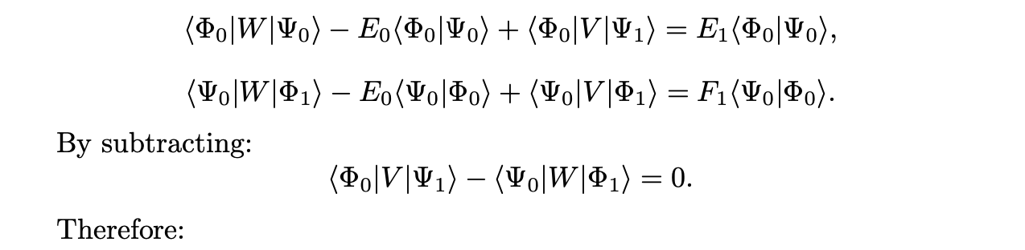
Dalgarno Interchange Theorem
Suppose we have two perturbations V and W. The first order equations are:
Multiply (1) by phi1 and (2) by psi_1, integrate and subtract, we get:
(1)
(2)
Calculating the Zeeman effect beyond first order in ³He | Evan M.R. Petrimoulx, University of Windsor
Notes:
HYLLERAAS IS ONLY FOR 2-3 BODY PROBLEMS

Slide 21
Relation to ³He⁺:
Combining the magnetic dipole moment with the quadratic Zeeman operator, we can write down the relativistic
corrections for ³He⁺ The V is the Quadratic Zeeman effect, and Q_{M1} is the magnetic dipole operator responsible for
the ordinary Zeeman effect and its relativistic corrections.
This result is of key interest to the g-2 experiment at the Max Planck Institute. This appears as a correction to their measurement!
This is the cross term between the Quadratic Zeeman Effect and the Relativistic Correction to the magnetic dipole moment operator
We can also extend this calculation to the 2-electron ³He case in future work, which is of key interest in the high precision magnetometer being built at the University of Michigan in Ann Arbor. Future work could include the investigation of the double Q_{M1} case, where V is a second Q_{M1}.
Calculating the Zeeman effect beyond first order in ³He | Evan M.R. Petrimoulx, University of Windsor
Notes:
HYLLERAAS IS ONLY FOR 2-3 BODY PROBLEMS

Slide 22
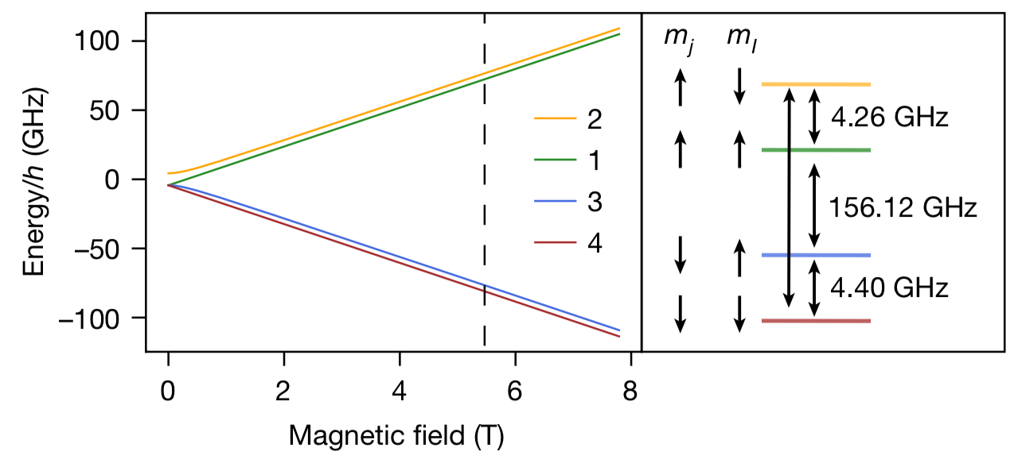
How it fits together:
The first term is the nuclear magnetic resonance term. The other terms are electronic magnetic resonance terms and are enhanced by . On the previous slide we calculate the cross term where both perturbations apply. ( and ). The term on its own gives zero due to orthogonality in the sum over states, so we need to include the relativistic correction. This is the (Q_{M1} term)
Where 𝛼 is the fine structure constant which squared is approximately:
Calculating the Zeeman effect beyond first order in ³He | Evan M.R. Petrimoulx, University of Windsor
Notes:
HYLLERAAS IS ONLY FOR 2-3 BODY PROBLEMS

Slide 23

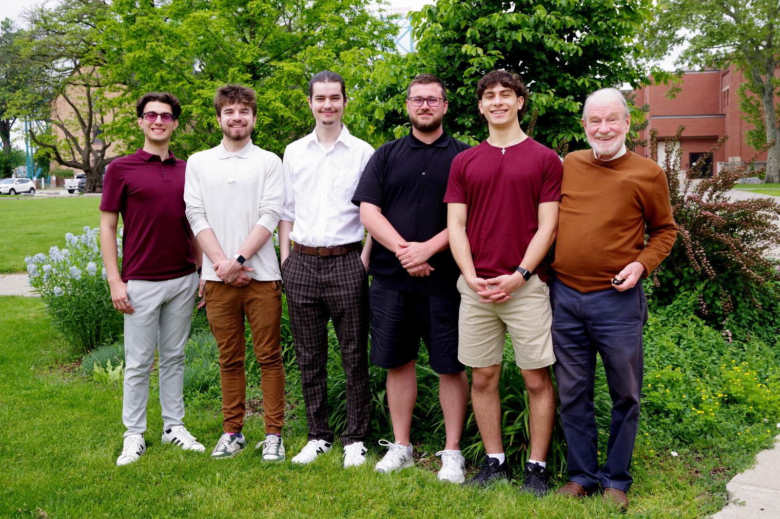

Concluding Remarks
Our files are now publicly available on GitHub!
https://github.com/Drake-Research-Group/dpol_public.git
Calculating the Zeeman effect beyond first order in ³He | Evan M.R. Petrimoulx, University of Windsor

